Slide 1
I210 – Introduction to Programming with Python
Lecture 10

Slide 2
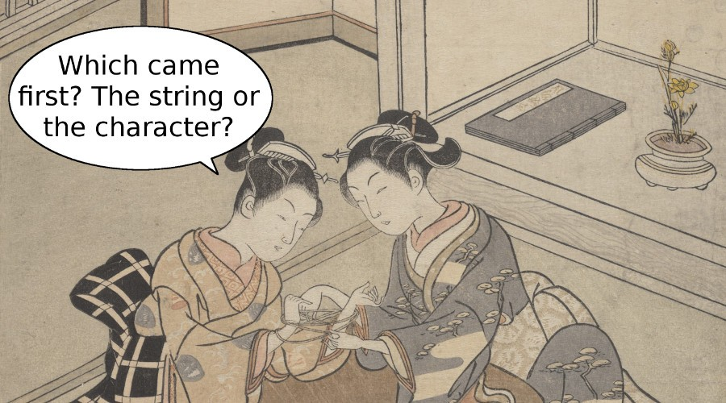
Today
Escape Sequences
Newlines and tabs
String methods
Slicing

Slide 3
Worried about LP 1? Revise it!
From the Syllabus:
Assignment Revision Policy
Assignments (homework, practicals) may be revised for a chance to earn up to 50% of the missed points back. For example, if you received a 70, but on your revised assignment received a 90, your final score will be an 80. You may not revise a score of 0.
You have up to a week from the date that homework is returned to go into any AI or UI lab office hour to revise that work. Course Instructors will not be available to revise assignments.
The final homework assignment and final lab practical may not be revised. Listen carefully for announcements made in class at the end of the semester about which assignments this specifically will apply to.

Slide 4

Key Problems
Starting today, we’ll be adding an icon to the slides.
When you see the gold star, you’ll know we’re on the key problem for the day – the one we expect to be most challenging, most informative, or both.
Make sure everyone in your group is comfortable with your solutions to these problems! They’re also a good idea to revisit for review.

Slide 5
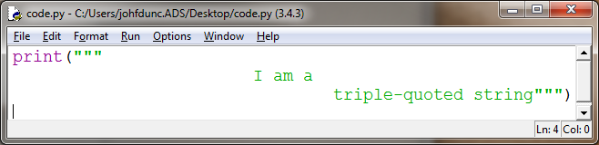
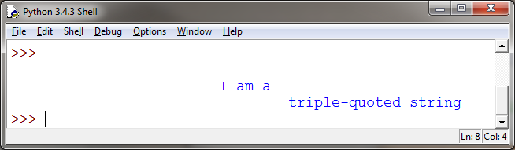
Strings: Using Quotes
Triple-quoted strings can span multiple lines and print out exactly as typed – good for long blocks of text or complex formatting!

Slide 6
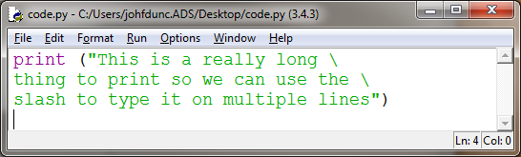
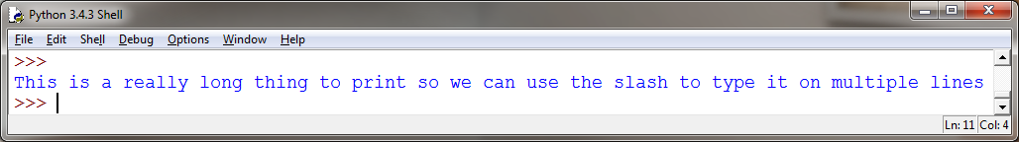
Strings: Line Breaks
Sometimes you'll have a really long string that you want to print on one line…
A \ at the very end of a line tells Python to ignore a line break

Slide 7
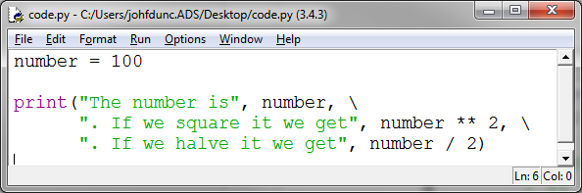
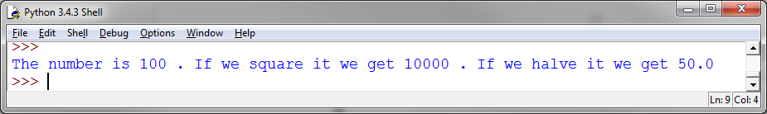
Strings: Line Breaks
We can also combine strings and operators across multiple lines (notice the \ is not in quotes!):

Slide 8
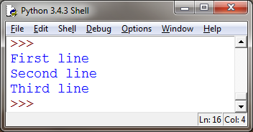
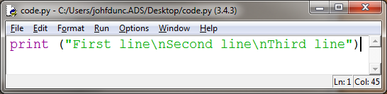
Strings: Using Escape Sequences
Escape sequence: Set of characters that allow you to insert special characters into a string
Backslash ( \ ) followed by another character
Newline character: \n
Escape sequences give you greater control and flexibility over the text you display

Slide 9
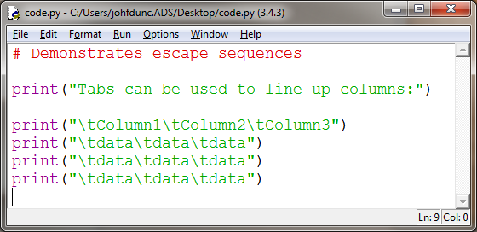
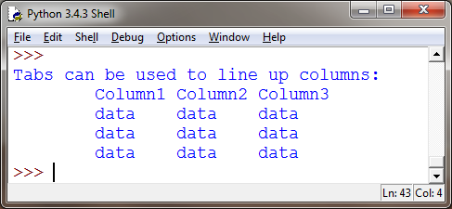
Strings: Using Escape Sequences
Tab character: \t

Slide 10
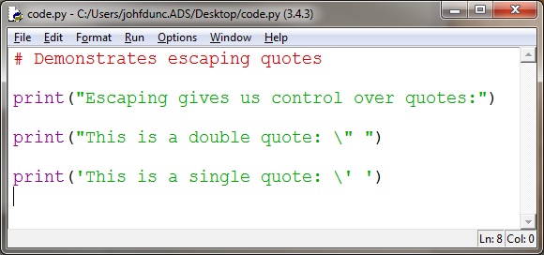
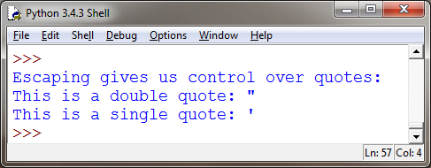
Strings: Using Escape Sequences
We can also escape single or double quotes:

Slide 11
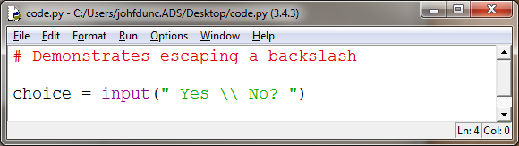
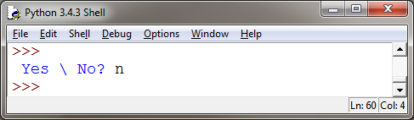
Strings: Using Escape Sequences
Because \ is used in escape sequences, if we just want to print out a "\", we have to escape the escape character!

Slide 12
Using String Methods
String methods allow you to do many things, including:
Create a new string with different capitalization that the original
Create a new string from the original, based on letter or word substitutions

Slide 13
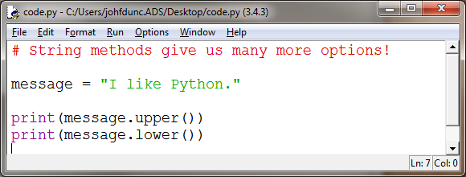
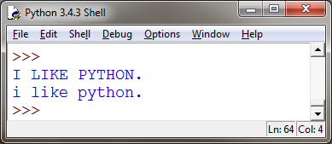
String Methods!
These two can be useful to test user input:
Compare user_text.upper() to "YES", so the user can enter "yes" or "Yes" or "YeS"
.upper(), .lower()

Slide 14
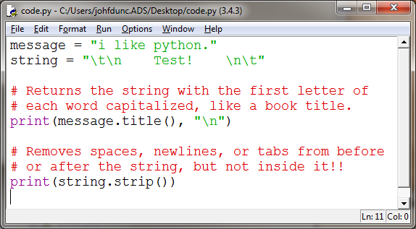
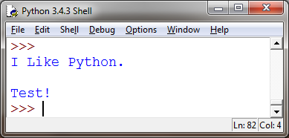
String Methods!
.title(), .strip()

Slide 15
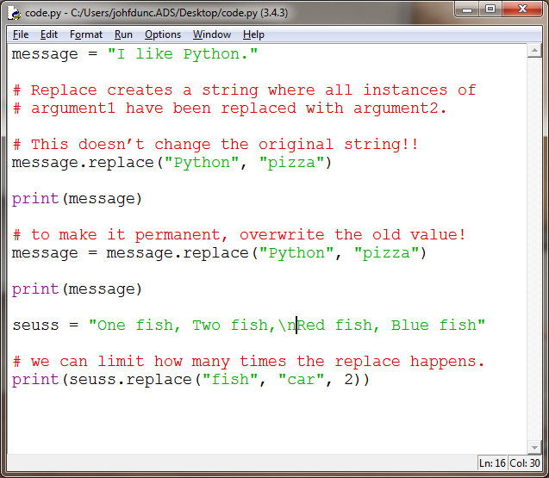
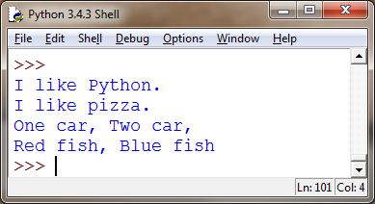
String Methods!
.replace()

Slide 16
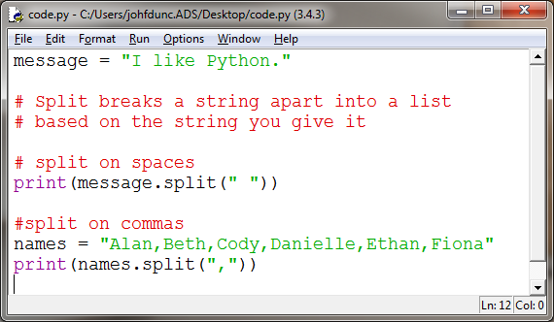
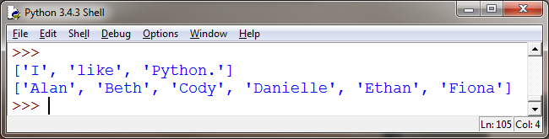
String Methods!
.split()

Slide 17
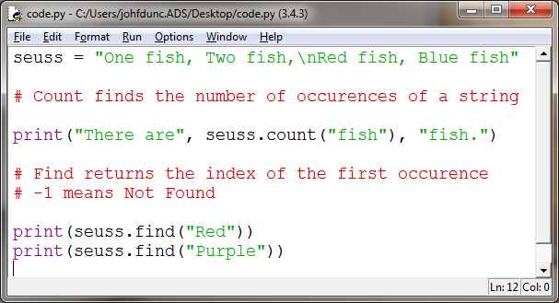
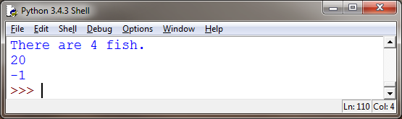
String Methods!
.count()

Slide 18
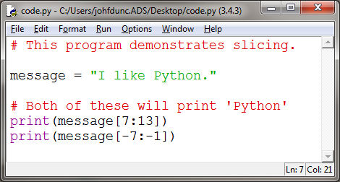
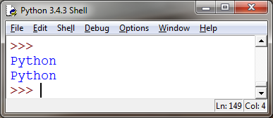
String Slicing
We can use slicing (and index numbers) to retrieve sections of a sequence:
The format is string [first index : last index]
Last index is NOT included!

Slide 19
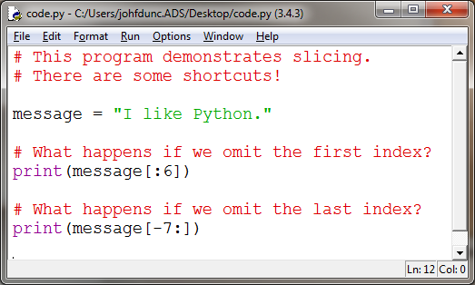
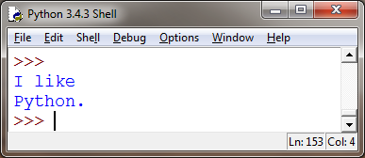
Slicing Shorthand

Slide 20
Questions?

